Slide 1
Business Cycles & Aggregate Demand – Aggregate Supply (AD-AS) Model
Aditi Chaubal
aditi@hss.iitb.ac.in
HS101 – Economics (Macroeconomics) - 2019

Slide 2
Role of fiscal policy in the multiplier model
Keynesian approach to macroeconomic policy: fiscal policy impacts economic activity and can be used to moderate business cycles
Fiscal policy instruments: Government spending (G) and taxation (T)
Impact of G on AD and GDP
Impact of taxes on AD and GDP
HS101 – Economics (Macroeconomics) - 2019

Slide 3
Role of fiscal policy in the multiplier model
Impact of G on AD and GDP
In multiplier model, introduce G in the total expenditure basket
Assume exogenous and constant level of investment
The assumption of GDP=DI ?
Can plot the consumption function against GDP as the GDP and DI only differ by the constant amount of taxes
Construct the consumption function for the economy against GDP (as taxes are constant) – how would the consumption function (with taxes) differ from one without taxes?
HS101 – Economics (Macroeconomics) - 2019

Slide 4
Role of fiscal policy in the multiplier model
TE = C + I + G
New equilibrium, E = point at which TE intersects the 45-degree line
New equilibrium: Equilibrium is attained when planned spending equals total planned output after adding government expenditure
HS101 – Economics (Macroeconomics) - 2019

Slide 5
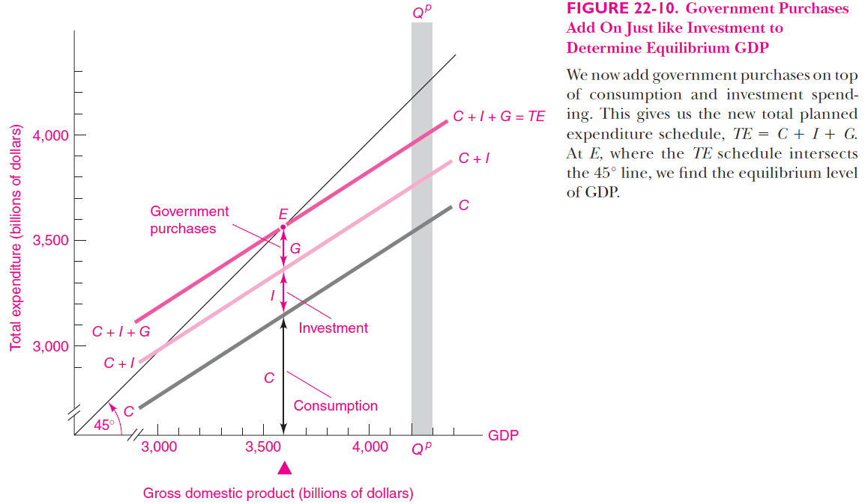
Ref: Samuelson & Nordhaus: Economics, 19th Ed

Slide 6
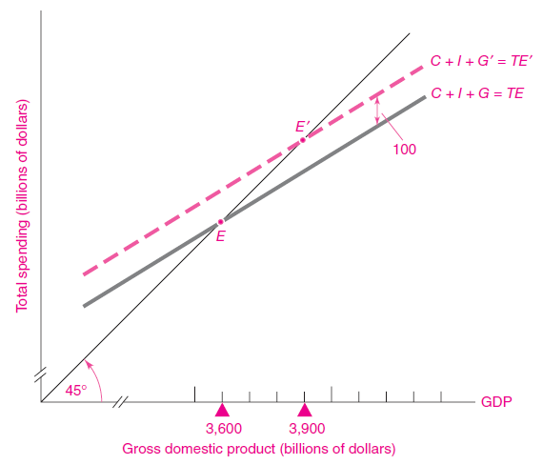

Ref: Samuelson & Nordhaus: Economics, 19th Ed
HS101 – Economics (Macroeconomics) - 2019

Slide 7
Role of fiscal policy in the multiplier model
Impact of taxes on AD and GDP
Introduce taxes in the total expenditure basket
Assume constant taxes (lump-sum taxes) – do not change with income or other economic variables
Assume exogenous and constant level of investment
The assumption of GDP=DI fails due to introduction of taxes
=> GDP = DI + Taxes
Construct the consumption function for the economy against GDP (as taxes are constant) – how would the consumption function (with taxes) differ from one without taxes?
HS101 – Economics (Macroeconomics) - 2019

Slide 8
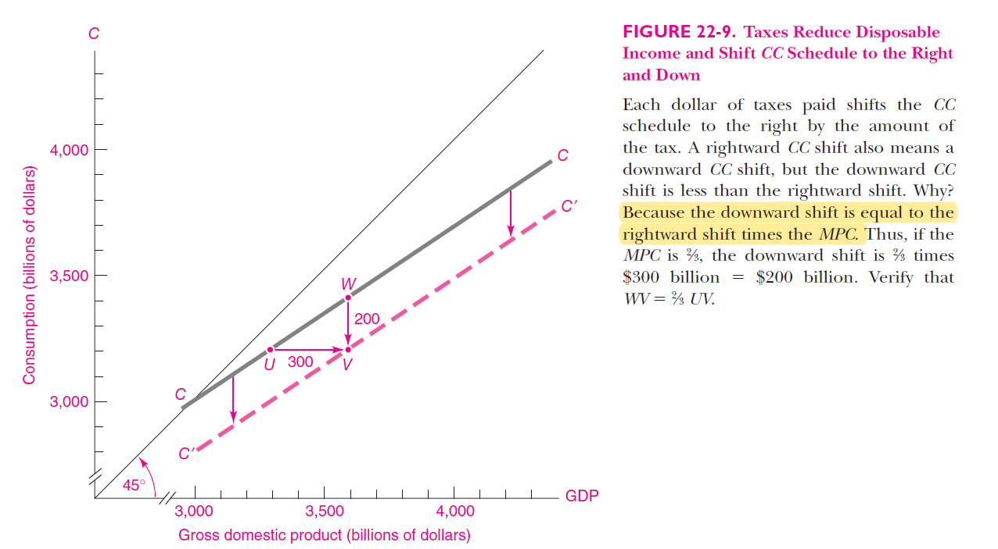
Impact of taxes on DI and C Ref: Samuelson & Nordhaus: Economics, 19th Ed

Slide 9
Role of fiscal policy in the multiplier model
Result: Taxes reduce AD and GDP
Extra taxes reduce DI
Reduction in C
Reduction in GDP and employment
In the multiplier model, higher taxes without increases in government purchases will tend to reduce real GDP
Dynamics of the multiplier model with G and T
What if TE greater or less than output?
HS101 – Economics (Macroeconomics) - 2019

Slide 10
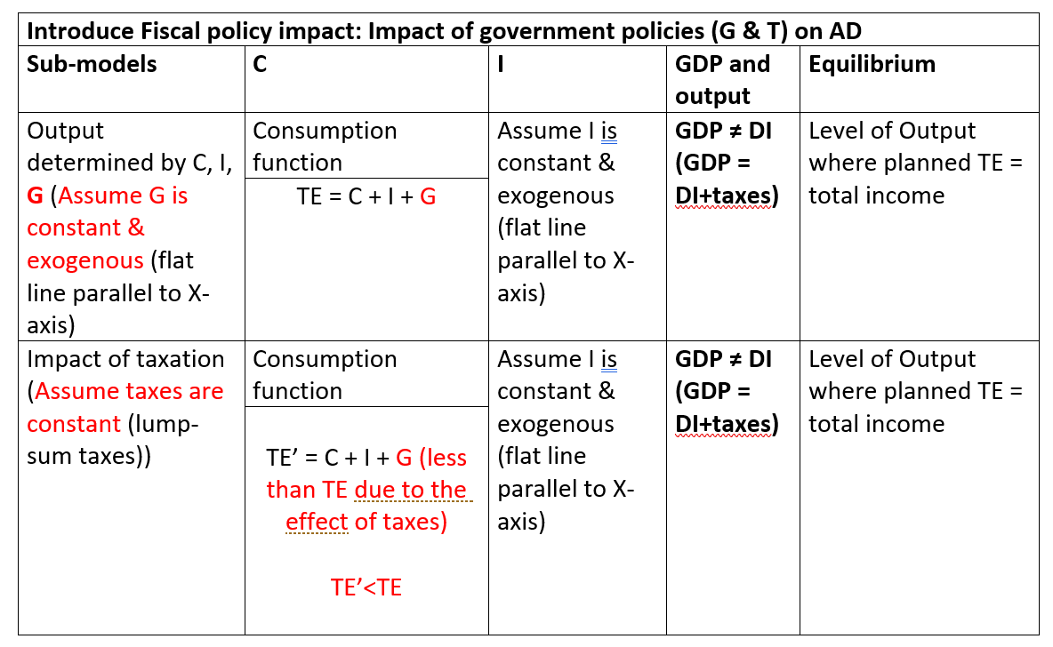
Impact of fiscal policy on AD
GDP=DI (only if no taxes)

Slide 11
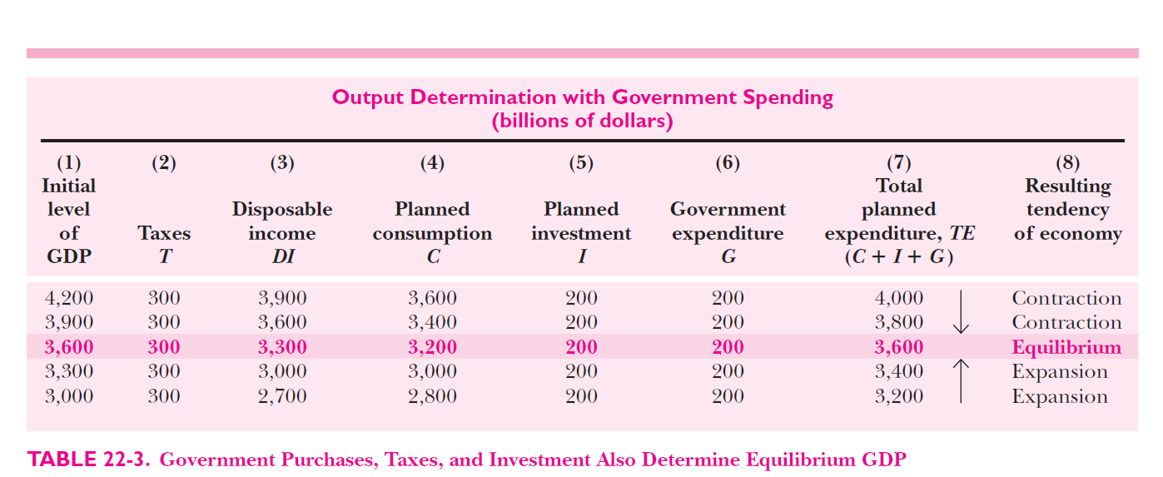
Numerical example Ref: Samuelson & Nordhaus: Economics, 19th Ed
HS101 – Economics (Macroeconomics) - 2019

Slide 12
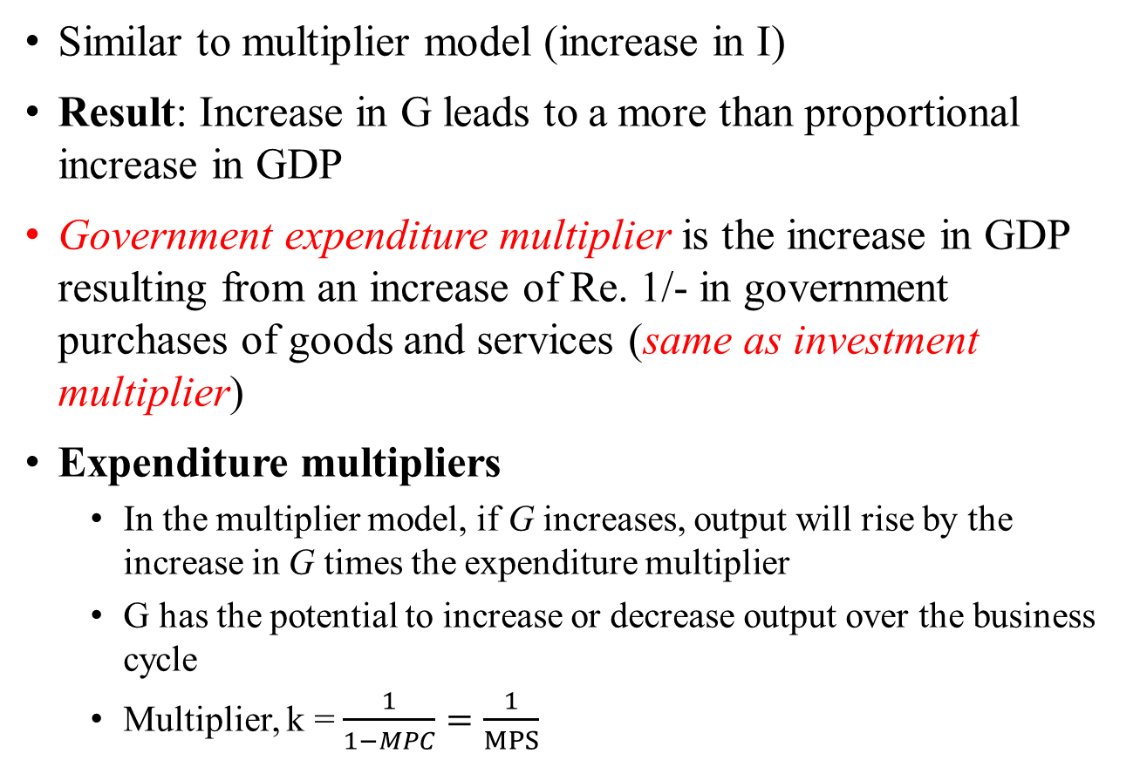
Fiscal policy multipliers
Similar to multiplier model (increase in I)
Result: Increase in G leads to a more than proportional increase in GDP
Government expenditure multiplier is the increase in GDP resulting from an increase of Re. 1/- in government purchases of goods and services (same as investment multiplier)
Expenditure multipliers
In the multiplier model, if G increases, output will rise by the increase in G times the expenditure multiplier
G has the potential to increase or decrease output over the business cycle
Multiplier, k = $\frac{1}{1−MPC}=\frac{1}{MPS}$
HS101 – Economics (Macroeconomics) - 2019

Slide 13
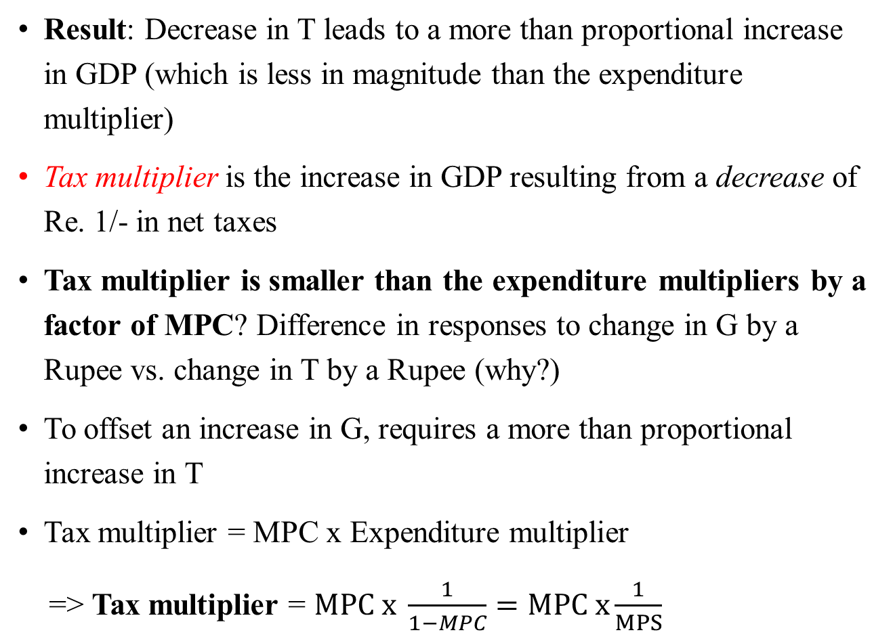
Fiscal policy multipliers – Tax multipliers
Result: Decrease in T leads to a more than proportional increase in GDP (which is less in magnitude than the expenditure multiplier)
Tax multiplier is the increase in GDP resulting from a decrease of Re. 1/- in net taxes
Tax multiplier is smaller than the expenditure multipliers by a factor of MPC? Difference in responses to change in G by a Rupee vs. change in T by a Rupee (why?)
To offset an increase in G, requires a more than proportional increase in T
Tax multiplier = MPC x Expenditure multiplier
=> Tax multiplier = $MPC x \frac{1}{1−MPC}=MPC x\frac{1}{MPS}$

Slide 14
The multiplier model and the business cycle
Multiplier model is the simplest model to explain business cycles
Internal theory of business cycle:
Multiplier model + Accelerator principle of investment
Provides a mechanism by which an exogenous shock tends to propagate through the economy in a cyclical manner
Every expansion breeds a recession/contraction and vice-versa
Accelerator principle: Rapid output growth stimulates investment amplified by multiplier (till full capacity after which growth slows); reverse process of slow growth leads to fall in investment leading to recession (till trough is reached after which economy stabilizes and recovers)
HS101 – Economics (Macroeconomics) - 2019

Slide 15
The Multiplier model & the macroeconomy: drawbacks
Aims:
Identify factors determining levels of national output
Short-run: Business cycles drive economy above or below long-term trend. This deviation of output and employment from long-run trend is analyzed with the multiplier model
Long-run: Potential output drives production and living standards
Drawbacks:
No financial markets and monetary policy
Closed economy: No interaction between domestic economy and rest of world
Excludes impact of supply side of the economy: interaction of spending with AS and prices
Oversimplified
HS101 – Economics (Macroeconomics) - 2019

Slide 16
Aggregate Supply: An introduction
Aggregate supply determinants
Potential or natural rate of output
Input costs
AS – Short-run vs. Long-run
Shifts in AS
Upward sloping vs. Vertical AS curves
3 theories explaining upward slope of AS
The sticky wage theory
The sticky price theory
The misperceptions theory
AS-AD dynamics
HS101 – Economics (Macroeconomics) - 2019

Slide 17
Aggregate Supply (AS)
Aggregate Supply (AS): is the quantity output businesses would willingly to produce and sell at each price level (given prices, costs and market conditions). It describes the behavior of the production side of the economy.
Formally: Total value of goods and services that firms would willingly produce in a given time period. It is a function of available inputs, technology and price level.
AS curve: shows the level of total output that will be produced at every possible price level, other things being held constant. The curve tends to be vertical at potential output in the long-run but is upward sloping in the short run.
Short-run: few months to a few years – Prices and wages are inflexible to business cycle fluctuations.
Long-run: several years or decades – Prices and wages are perfectly flexible.
HS101 – Economics (Macroeconomics) - 2019

Slide 18
AS Determinants
AS determined by: (i) Potential output & (ii) Input/Production costs
Potential output: Highest sustainable level of output which can be produced by the economy with the given the factors of production (technology, labour, capital, and natural resources, etc.)
It is the maximum output an economy can produce without triggering inflationary pressures.
It is measured as the output that would be produced at a benchmark level of unemployment (Non-accelerating inflation rate of unemployment, NAIRU)
NAIRU is the unemployment rate consistent with a constant inflation rate. At the NAIRU, upward and downward forces on price and wage inflation are in balance, so there is no tendency for inflation to change. The NAIRU is the lowest unemployment rate that can be sustained without upward pressure on inflation
HS101 – Economics (Macroeconomics) - 2019

Slide 19
AS Determinants
Potential output is NOT the absolute maximum output that a country produces
Potential output is a growing target determined by:
Inputs (factors of production – L, K, land, etc.)
Technological progress and efficiency
Growth in inputs => increase in potential output => shift in AS
Technological progress => increase in potential output => shift in AS
HS101 – Economics (Macroeconomics) - 2019

Slide 20
AS Determinants
Input/production costs: tend to affect AS in the short-run as businesses have certain costs which are inflexible. E.g. wages, import prices, etc.
Changes in input and production costs impact and shift the AS curve
Lower costs => greater aggregate supply => shifts in AS
Summarizing,
Increase in potential output (ceteris paribus) => AS shifts outward
Increase in production costs (ceteris paribus) => AS shifts upward
HS101 – Economics (Macroeconomics) - 2019

Slide 21
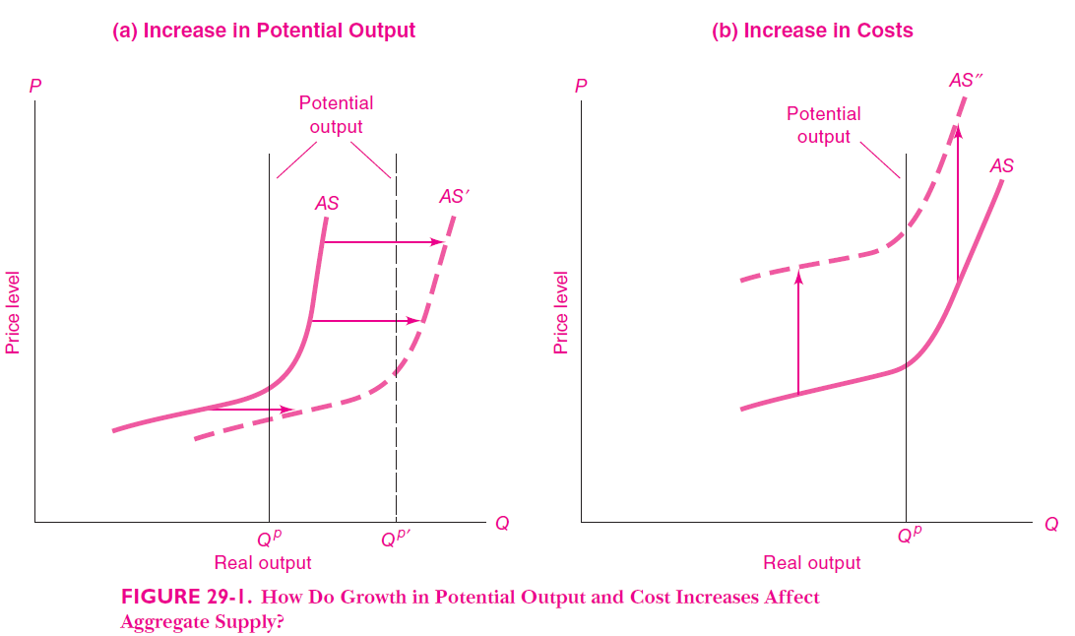
Shifts in AS curve (short-run) (Ref: Samuelson & Nordhaus: Economics, 19th Ed)
HS101 – Economics (Macroeconomics) - 2019

Slide 22
AS curve – Short-run vs. Long-run
Short-run AS curve (Keynesian)
The SR-AS curve is upward sloping
An increase in the overall level of prices in the economy tends to raise the quantity of goods and services supplied.
A decrease in the level of prices tends to reduce the quantity of goods and services supplied.
HS101 – Economics (Macroeconomics) - 2019

Slide 23
SR-AS curve
Three theories for upward slope:
The sticky-wage theory
The sticky-price theory
The misperceptions theory
The Sticky-Wage Theory (↓Price => ↓Output)
Nominal wages are slow to adjust to changing economic conditions, or are “sticky” in the short run
Nominal wages do not adjust immediately to a fall in the price level. A lower price level makes employment and production less profitable
This induces firms to reduce the quantity of goods and services supplied
HS101 – Economics (Macroeconomics) - 2019

Slide 24
SR-AS curve
The Sticky-Price Theory (↓Price => ↓Output)
Prices of some goods and services adjust sluggishly in response to changing economic conditions.
An unexpected fall in the price level leaves some firms with higher-than-desired prices. For a variety of reasons, they may not want to or be able to change prices immediately.
This depresses sales, which induces firms to reduce the quantity of goods and services they produce.
The Misperceptions Theory (↓Price => ↓Output)
Changes in the overall price level temporarily mislead suppliers about what is happening in the markets in which they sell their output.
A lower price level causes misperceptions about relative prices.
These misperceptions induce suppliers to decrease the quantity of goods and services supplied.
HS101 – Economics (Macroeconomics) - 2019

Slide 25
SR-AS curve
All three theories suggest that output deviates in the short-run from the natural rate when the actual price level deviates from the price level that people had expected to prevail.
HS101 – Economics (Macroeconomics) - 2019

Slide 26
LR-AS curve – Intuition
In the long-run, inflexible or sticky elements of cost—wage contracts, rental agreements, regulated prices etc.—become unstuck and negotiable.
Firms will be unable to profit from the higher level of aggregate demand. In the long run, after all elements of cost have fully adjusted, firms will face the same ratio of price to costs as they did before the change in demand.
There will be no incentive for firms to increase their output.
The long-run AS curve is thus vertical => output supplied is independent of the level of prices and costs.
HS101 – Economics (Macroeconomics) - 2019

Slide 27
LR-AS curve – Important concepts
Nominal variables are variables measured in monetary units. E.g. prices, income, nominal GDP, etc.
Real variables are variables measured in physical units. E.g. relative prices, real wage, real interest rates, etc.
Classical dichotomy: Different forces influence real and nominal variables.
Real economic variables do not change with changes in the money supply.
Changes in the money supply affect nominal variables but not real variables.
The irrelevance of monetary changes for real variables is called monetary neutrality.
HS101 – Economics (Macroeconomics) - 2019

Slide 28
LR-AS curve
Long-run AS curve
The AS curve is vertical because the price level does not affect long run determinants of real GDP.
An economy’s production of goods and services depends on its supplies of labor, capital, and natural resources and on the available technology used to turn these factors of production into goods and services.
The price level does not affect these variables in the long run.
Any change in the economy that alters the natural rate of output shifts the long-run aggregate-supply curve.
The shifts may be categorized according to the various factors in the classical model that affect output.

Slide 29
Shifts in AS curve
SR-AS | LR-AS
Expected Price Level: ↑P^{e} => AS shifts Left Labour: ↑L => AS shifts right Capital (or human): ↑K => AS shifts right Natural Resources: ↑NR => AS shifts right Technology: ↑Tech => AS shifts right | Labour: ↑L => AS shifts right NAIRU ↑ => AS shifts left Capital (or human): ↑K => AS shifts right Natural Resources: ↑NR => AS shifts right Technology: ↑Tech => AS shifts right
HS101 – Economics (Macroeconomics) - 2019

Slide 30
AS-AD dynamics
Recall:
AD and its determinants (C, I, G, NX)
AD slopes downward – wealth effect (C), interest rate effect (I), exchange rate effect (NX)
Shifts in AD curve
The aggregate-demand curve shows the quantity of goods and services that households, firms, and the government want to buy at each price level.
The aggregate-supply curve shows the quantity of goods and services that firms choose to produce and sell at each price level.
The AS-AD model helps understand short-run fluctuations in the economy; and helps describe the country’s long-run trends (LR-AS curve).
HS101 – Economics (Macroeconomics) - 2019

Slide 31
The AS-AD equilibrium (Ref: Mankiw, G. (2007): Principles of Economics)
Price
Level
Long-run
aggregate
supply
Short-run
aggregate
supply
Equilibrium
A
price
Aggregate
demand
0
Natural rate
Quantity of
of output
Output

Slide 32
Long-Run AS-AD dynamics (Ref: Mankiw, G. (2007): Principles of Economics)
2. . . . and growth in the
Long-run
money supply shifts
aggregate
aggregate demand . . .
supply,
LRAS
1980
LRAS
1990
LRAS
2000
Price
Level
1. In the long run,
technological
progress shifts
P
2000
long-run aggregate
4. . . . and
supply . . .
ongoing inflation.
P
1990
Aggregate
Demand,
AD
2000
P
1980
AD
1990
AD
1980
0
Y
1980
Y
1990
Y
2000
Quantity of
Output
3. . . . leading to growth
in output . . .

Slide 33
Contraction in Aggregate Demand (Ref: Mankiw, G. (2007): Principles of Economics)
2. . . . causes output to fall in the short run . . .
Price
Level
Long-run
Short-run aggregate
aggregate
supply,
AS
supply
AS₂
3. . . . but over
time, the short-run
P
A
aggregate-supply
curve shifts . . .
P₂
B
1. A decrease in
P₃
C
aggregate demand . . .
Aggregate
demand,
AD
AD₂
0
Y₂
Y
Quantity of
4. . . . and output returns
Output
to its natural rate.

Slide 34
Adverse Shift in Aggregate Supply (Ref: Mankiw, G. (2007): Principles of Economics)
1. An adverse shift in the short-
run aggregate-supply curve . . .
Price
Level
Long-run
Short-run
aggregate
AS₂
aggregate
supply
supply,
AS
B
P₂
A
P
3. . . . and
the price
level to rise.
Aggregate demand
0
Y₂
Y
Quantity of
2. . . . causes output to fall . . .
Output

Slide 35
Accommodating an Adverse Shift in AS – Policy response by expanding AD (Ref: Mankiw, G. (2007): Principles of Economics)
1. When short-run aggregate
supply falls . . .
Price
Level
Long-run
Short-run
aggregate
AS₂
aggregate
supply
supply,
AS
P₃
C
2. . . . policymakers can
P₂
accommodate the shift
A
by expanding aggregate
3. . . . which
P
demand . . .
causes the
price level
to rise
4. . . . but keeps output
AD₂
further . . .
at its natural rate.
Aggregate demand,
AD
0
Natural rate
Quantity of
of output
Output

Slide 36
Summarizing,
Steps to analyze AS-AD dynamics
Decide whether the event/shock shifts AS or AD or both
Decide which direction the curve shifts
Use diagram of AS-AD to determine impact on price level and output
Use diagram of AS-AD to analyze how economy moves to new short-run and/or long-run equilibrium or its earlier long-run equilibrium
Shifts in AD
Short-run: shifts in AD impact the output of goods and services (and prices)
Long-run: shifts in AD impact overall price level but have no impact on output
HS101 – Economics (Macroeconomics) - 2019

Slide 37
Summarizing,
Shifts in AS
Sticky prices and wages + Assume AD is held constant
Negative shock: shifts in SR-AS impact prices and wages resulting in higher prices and falling output (Stagflation)
Wage-price spiral: Higher prices lead to higher wages leading to even higher prices
Is the spiral infinite? Growth in wages slows when unemployment increases, and workers have low bargaining power.
In the long-run, nominal wages fall and output recovers to its potential level.
Relax assumption of constant AD => policy response to AS shock by boosting demand at cost of inflation (Accommodative policy) => higher prices but same potential output.
HS101 – Economics (Macroeconomics) - 2019

Slide 38
What we have not covered yet?
Impact of monetary policy on AS-AD
Classical dichotomy and Money neutrality
Stabilization theory
HS101 – Economics (Macroeconomics) - 2019

Slide 39
Thank You

